Slide 1
Chapter 4 The Components of the System Unit

Slide 2
Chapter 4 Objectives
Differentiate among various styles of system units
Differentiate among the various types of memory
Identify chips, adapter cards, and other components of a motherboard
Describe the types of expansion slots and adapter cards
Describe the components of a processor and how they complete a machine cycle
Explain the differences among a serial port, a parallel port, a USB port, a FireWire port, and other ports
Identify characteristics of various personal computer processors on the market today
Describe how buses contribute to a computer’s processing speed
Define a bit and describe how a series of bits represents data
Identify components in mobile computers and mobile devices
Explain how programs transfer in and out of memory
Understand how to clean a system unit
Next

Slide 3
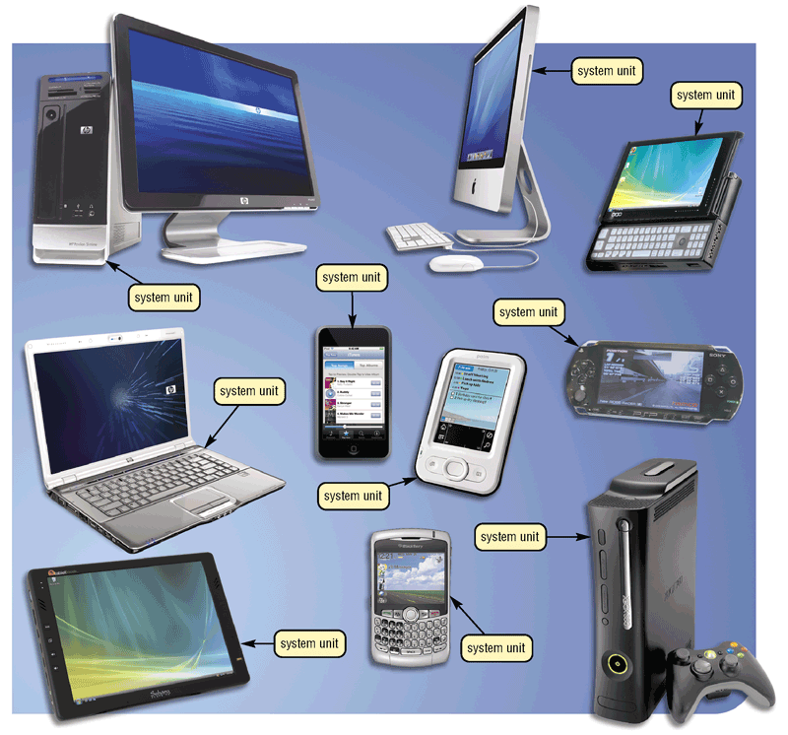
The System Unit
What is the system unit?
Case that contains electronic components of the computer used to process data
Sometimes called the chassis
p. 184 Fig. 4-1
Next

Slide 4
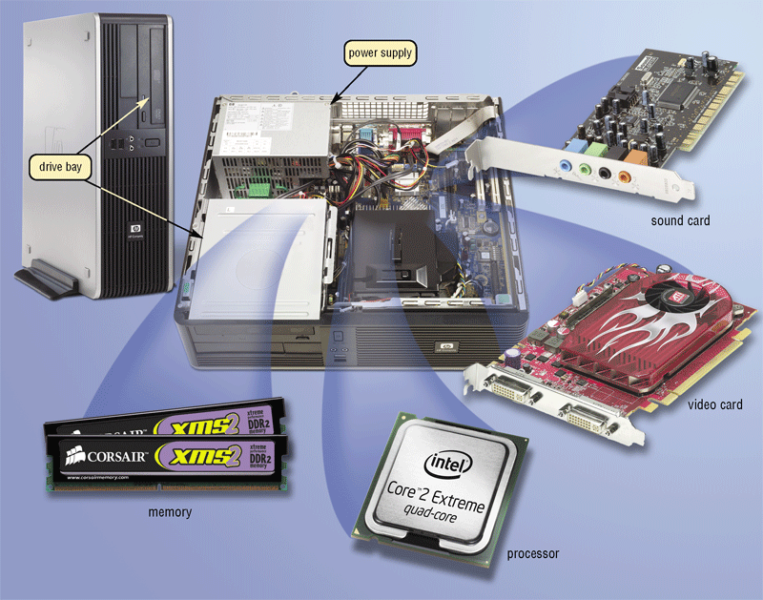
The System Unit
What are common components inside the system unit?
Processor
Memory
Adapter cards
Sound card
Video card
Drive bays
Power supply
p. 185 Fig. 4-2
Next

Slide 5
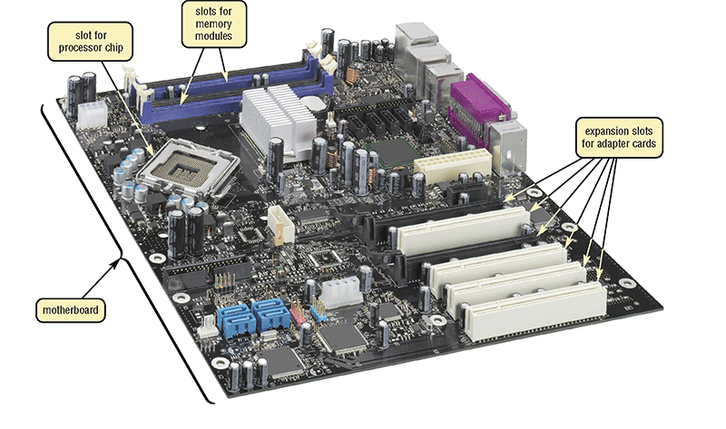
The System Unit
What is the motherboard?
Main circuit board of the system unit
Contains expansion slots, processor chips, and memory slots
Also called system board
Click to view Web Link, click Chapter 4, Click Web Link from left navigation,
then click Motherboards below Chapter
p. 186 Fig. 4-3
Next

Slide 6
The System Unit
What is a chip?
Small piece of semi-conducting material on which integrated circuits are etched
Integrated circuits contain many microscopic pathways capable of carrying electrical current
Chips are packaged so that they can be attached to a circuit board
p. 186
Next

Slide 7
Processor
What is the central processing unit (CPU)?
Interprets and carries out basic instructions that operate a computer
Processor
Control Unit
Arithmetic Logic Unit (ALU)
Control Unit
Arithmetic Logic Unit (ALU)
Control unit directs and coordinates operations in computer
Instructions Data Information
Arithmetic logic unit (ALU) performs arithmetic, comparison, and logical operations
Memory
Input Devices
Data
Information
Output Devices
Instructions Data Information
Also called the processor
Storage Devices
p. 186 - 187 Fig. 4-4
Next

Slide 8
Processor
What are multi-core processors?
A multi-core processor is a chip with two or more separate processors
A dual-core processor is a single chip that contains two separate processors
A quad-core processor is a single chip that contains four separate processors
Each processor on a multi-core chip generally runs at a slower clock speed, but increases overall performance
Click to view Web Link, click Chapter 4, Click Web Link from left navigation,
then click Quad-Core Processors below Chapter 4
p. 187
Next

Slide 9

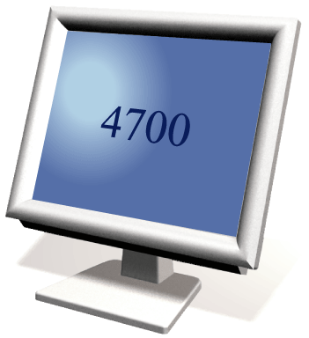
Processor
What is a machine cycle?
Four operations of the CPU comprise a machine cycle
Step 1. Fetch Obtain program instruction or data item from memory
Memory
Step 2. Decode Translate instruction into commands
Step 4. Store Write result to memory
Processor
ALU
Control Unit
Step 3. Execute Carry out command
p. 188 Fig. 4-5
Next

Slide 10
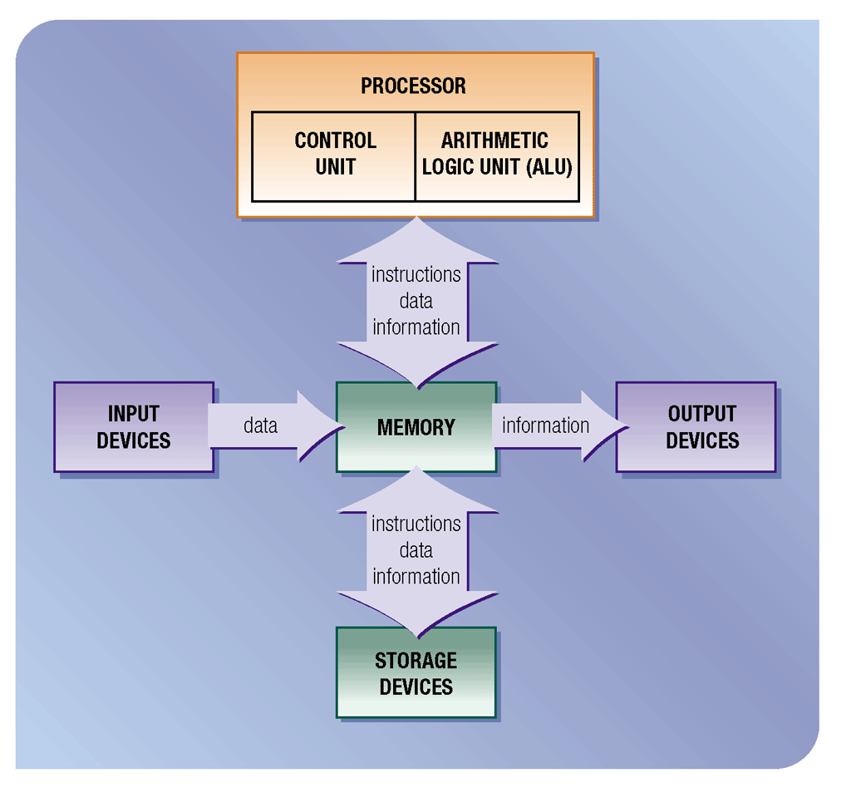
Processor
What is pipelining?
Processor begins fetching second instruction before completing machine cycle for first instruction
Results in faster processing
p. 189 Fig. 4-6
Next

Slide 11
Processor
What is a register?
Temporary high-speed storage area that holds data and instructions
Stores location from where instruction was fetched
Stores instruction while it is being decoded
Stores data while ALU computes it
Stores results of calculation
p. 189
Next

Slide 12
Processor
What is the system clock?
Controls timing of all computer operations
Generates regular electronic pulses, or ticks, that set operating pace of components of system unit
Each tick is a clock cycle
Pace of system clock is clock speed
Most clock speeds are in the gigahertz (GHz) range (1 GHz = one billion ticks of system clock per second)
Processor speed can also be measured in millions of instructions per second (MIPS)
p. 189 - 190
Next

Slide 13
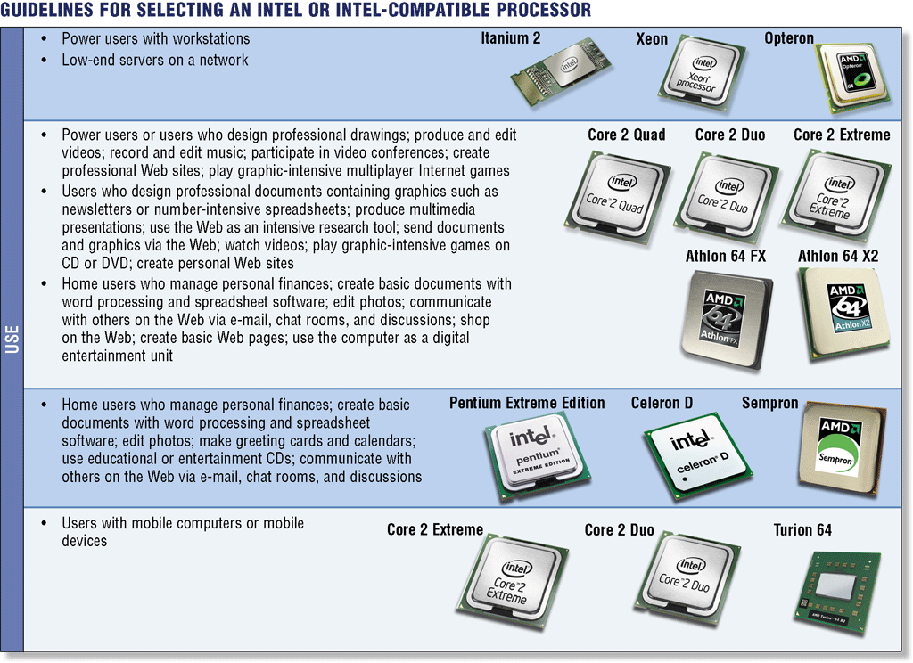
Processor
What are the guidelines for selecting a processor?
p. 192 Fig. 4-8
Next

Slide 14
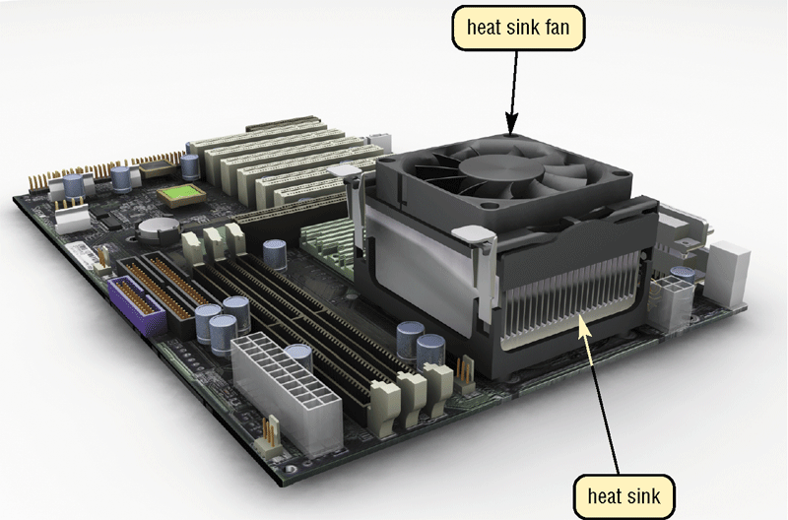
Processor
What are heat sinks, heat pipes, and liquid cooling?
Heat sink—component with fins that cools processor
Heat pipee—smaller device for notebook computers
Liquid cooling—uses a continuous flow of fluids to transfer heat away
p. 193 Fig. 4-9
Next

Slide 15
Processor
What is parallel processing?
Using multiple processors simultaneously to execute a program faster
Requires special software to divide problem and bring results together
Control Processor
Processor 1
Processor 2
Processor 3
Processor 4
Memory
Memory
Memory
Memory
results combined
p. 194 Fig. 4-10
Next

Slide 16
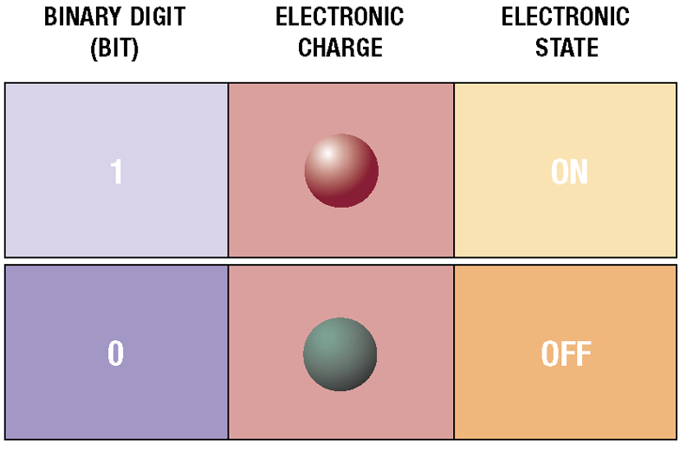
Data Representation
How do computers represent data?
Most computers are digital
Recognize only two discrete states: on or off
Use a binary system to recognize two states
Use Number system with two unique digits: 0 and 1, called bits (short for binary digits)
p. 194 - 195 Fig. 4-11
Next

Slide 17
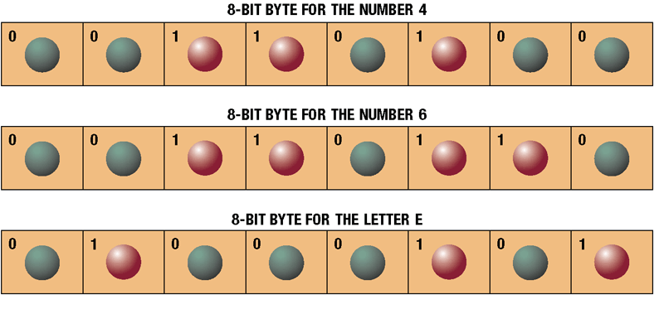
Data Representation
What is a byte?
Eight bits grouped together as a unit
Provides enough different combinations of 0s and 1s to represent 256 individual characters
Numbers
Uppercase and lowercase letters
Punctuation marks
Other
p. 195 Fig. 4-12
Next

Slide 18
Data Representation
What are three popular coding systems to represent data?
ASCII—American Standard Code for Information Interchange
EBCDIC—Extended Binary Coded Decimal Interchange Code
Unicode—coding scheme capable of representing all world’s languages
ASCII Symbol EBCDIC
00110000 0 11110000
00110001 1 11110001
00110010 2 11110010
00110011 3 11110011
p. 195 Fig. 4-13
Next

Slide 19
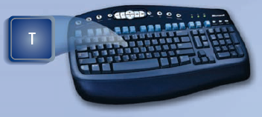
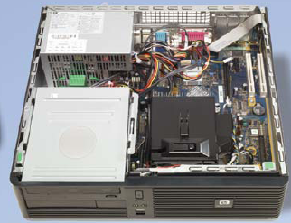
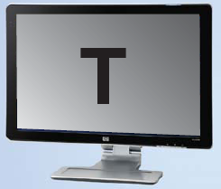
Data Representation
How is a letter converted to binary form and back?
Step 1. The user presses the capital letter T (SHIFT+T key) on the keyboard.
Step 2. An electronic signal for the capital letter T is sent to the system unit.
Step 3. The system unit converts the scan code for the capital letter T to its ASCII binary code (01010100) and stores it in memory for processing.
Step 4. After processing, the binary code for the capital letter T is converted to an image, and displayed on the output device.
p. 196 Fig. 4-14
Next

Slide 20
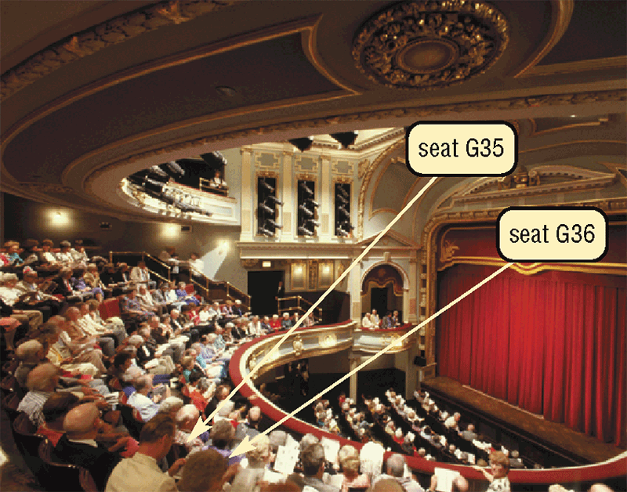
Memory
What is memory?
Electronic components that store instructions, data, and results
Consists of one or more chips on motherboard or other circuit board
Each byte stored in unique location called an address, similar to seats in a concert hall
p. 197 Fig. 4-15
Next

Slide 21
Memory
How is memory measured?
By number of bytes available for storage
Term Abbreviation Approximate Size
Kilobyte KB or K 1 thousand bytes
Megabyte MB 1 million bytes
Gigabyte GB 1 billion bytes
Terabyte TB 1 trillion bytes
p. 197 Fig. 4-16
Next

Slide 22
Memory
What is random access memory (RAM)?
Memory chips that can be read from and written to by processor
Also called main memory or primary storage
Most RAM is volatile, it is lost when computer’s power is turned off
The more RAM a computer has, the faster it responds
Click to view Web Link, click Chapter 4, Click Web Link from left navigation,
then click RAM below Chapter
p. 198 - 199
Next

Slide 23
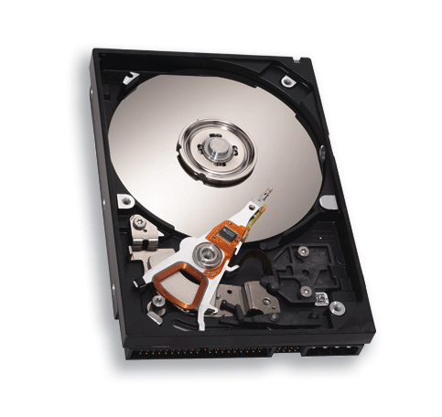
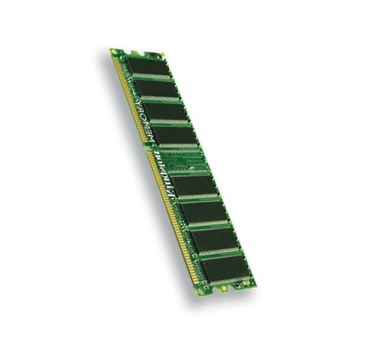
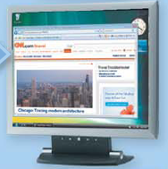
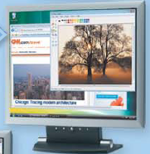
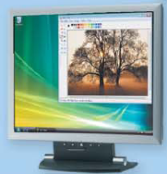
Memory
How do program instructions transfer in and out of RAM?
RAM
Step 1. When you start the computer, certain operating system files are loaded into RAM from the hard disk. The operating system displays the user interface on the screen.
Operating system instructions
Operating system interface
Step 2. When you start a Web browser, the program’s instructions are loaded into RAM from the hard disk. The Web browser window is displayed on the screen.
Web browser instructions
Web browser window
Step 3. When you start a paint program, the program’s instructions are loaded into RAM from the hard disk. The paint program, along with the Web Browser and certain operating system instructions are in RAM. The paint program window is displayed on the screen.
Paint program instructions
Paint program window
RAM
Step 4. When you quit a program, such as the Web browser, its program instructions are removed from RAM. The Web browser is no longer displayed on the screen.
Web browser program instructions are removed from RAM
Web browser window is no longer displayed on desktop
p. 198 Fig. 4-17
Next

Slide 24

Memory
Video: The Leopard with a Time Machine
CLICK TO START
Next

Slide 25
Memory
What are two basic types of RAM chips?
Most common type
Do not have to be re-energized as often as DRAM
Dynamic RAM (DRAM)
Static RAM (SRAM)
Must be re-energized constantly
Faster and more reliable than DRAM chips
Newer Type: Magnetoresistive RAM (MRAM)
p. 199
Next

Slide 26
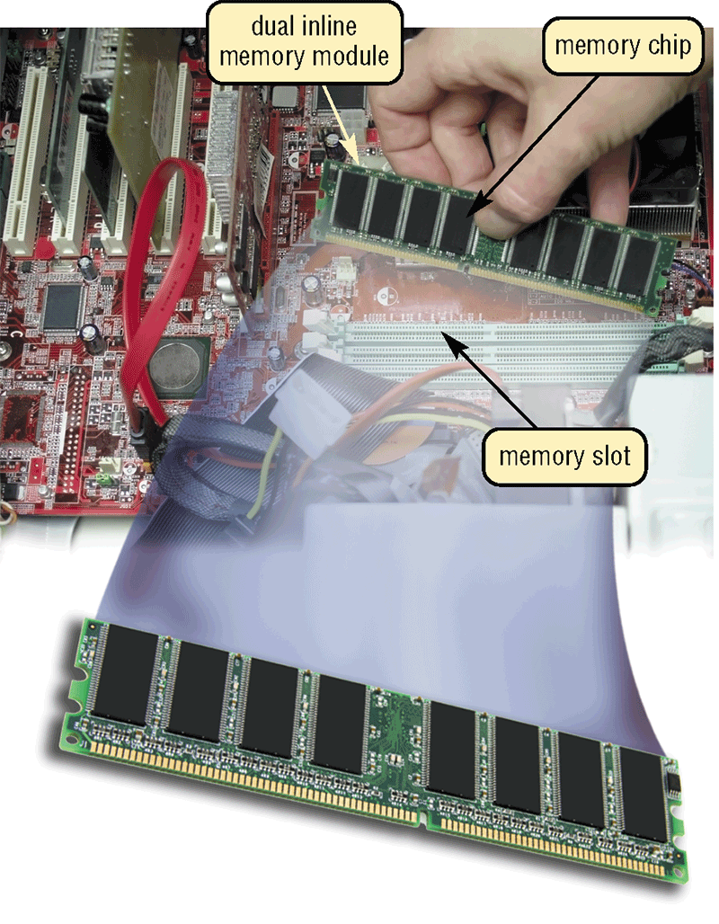
Memory
Where does memory reside?
Resides on small circuit board called memory module
Memory slots on motherboard hold memory modules
p. 199 Fig. 4-18
Next

Slide 27
Memory
How much RAM does an application require?
Depends on the types of software you plan to use
For optimal performance, you need more than minimum specifications
p. 199
Next

Slide 28
Memory
How much RAM do you need?
Depends on type of applications you intend to run on your computer
RAM
1 GB or less
1 GB to 4 GB
4 GB and up
Use
Home and business users managing personal finances
Using standard application software such as word processing
Using educational or entertainment CDs
Communicating with others on the Web
Users requiring more advanced multimedia capabilities
Running number-intensive accounting, financial, or spreadsheet programs
Using voice recognition
Working with videos, music, and digital imaging
Creating Web sites
Participating in video conferences
Playing Internet games
Power users creating professional Web sites
Running sophisticated CAD, 3-D design, or other graphics-intensive software
p. 200 Fig. 4-19
Next

Slide 29
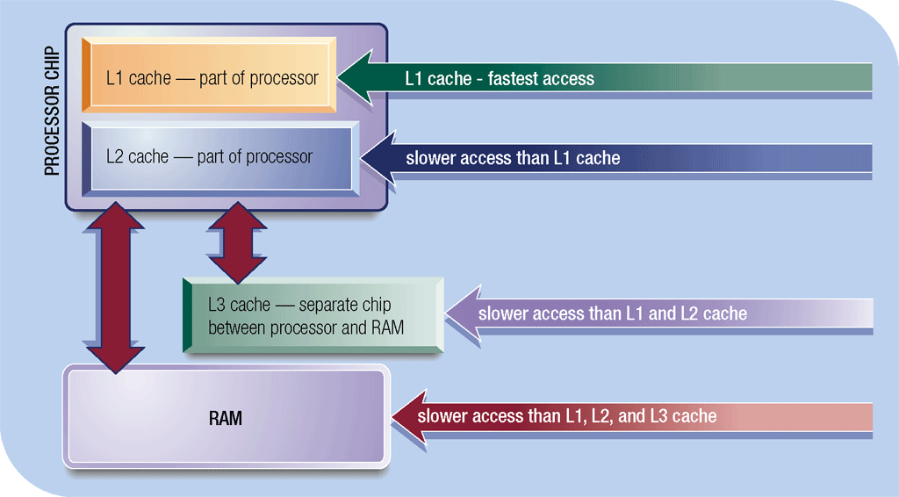
Memory
What is cache?
Helps speed computer processes by storing frequently used instructions and data
Also called memory cache
L1 cache built into processor
L2 cache slower but has larger capacity
L2 advanced transfer cache is faster, built directly on processor chip
L3 cache is separate from processor chip on motherboard (L3 is only on computers that use L2 advanced transfer cache)
Click to view Web Link, click Chapter 4, Click Web Link from left navigation, then click Windows ReadyBoost below Chapter 4
p. 201 Fig. 4-20
Next

Slide 30
Memory
What is read-only memory (ROM)?
Memory chips that store permanent data and instructions
Nonvolatile memory, it is not lost when computer’s power is turned off
Three types:
Firmware— Manufactured with permanently written data, instructions, or information
EEPROM (electrically erasable programmable read-only memory)— Type of PROM containing microcode programmer can erase
PROM (programmable read-only memory)— Blank ROM chip onto which a programmer can write permanently
p. 201 - 202
Next

Slide 31
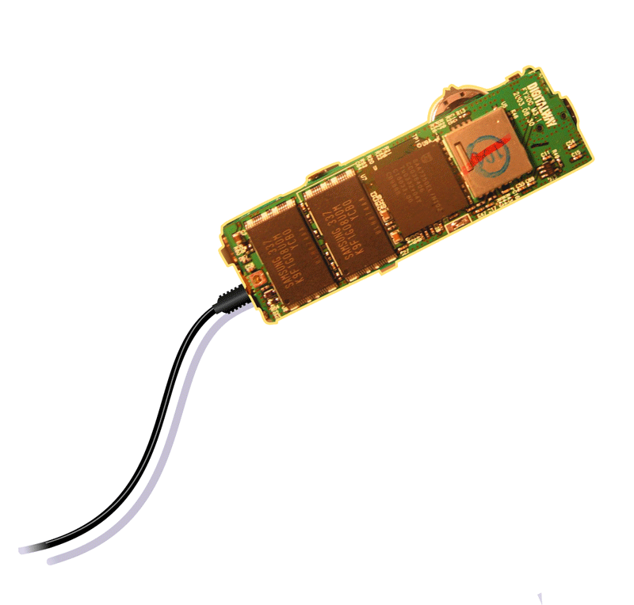
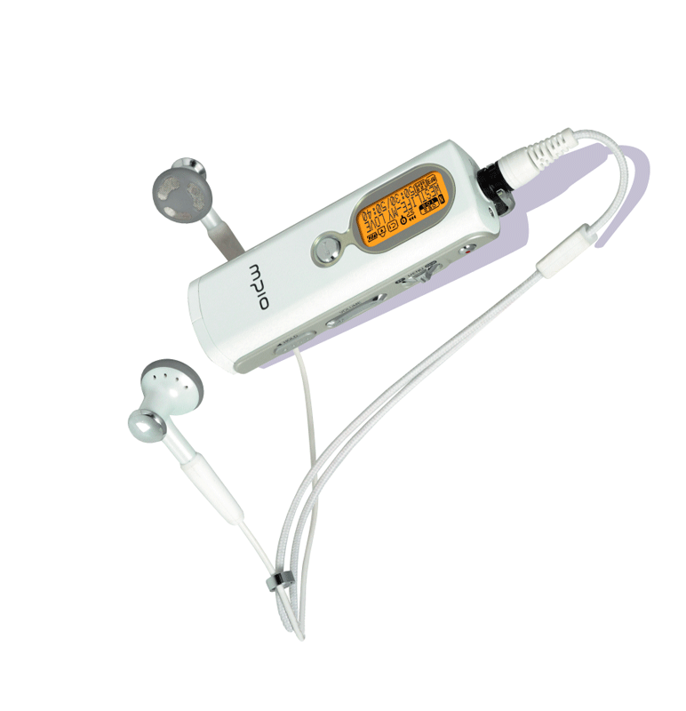
Memory
What is flash memory?
Nonvolatile memory that can be erased electronically and rewritten
Used with many mobile devices
Step 3. Plug the headphones into the portable media player, push a button on the portable media player, and listen to the music through the earphones.
Step 1. Purchase and download music tracks from a Web site. With one end of a special cable connected to the system unit, connect the other end to the USB port in the portable media player.
flash memory chips
USB port
Click to view Web Link, click Chapter 4, Click Web Link from left navigation,
then click Flash Memory below Chapter 4
Step 2. Instruct the computer to copy the music tracks to the flash memory chip in the portable media player.
MP3 Player
p. 202 Fig. 4-21
Next

Slide 32
Memory
What is CMOS?
Complementary metal-oxide semiconductor memory
Used in some RAM chips, flash memory chips, and other types of memory chips
Uses battery power to retain information when other power is turned off
Stores date, time, and computer’s startup information
p. 203
Next

Slide 33
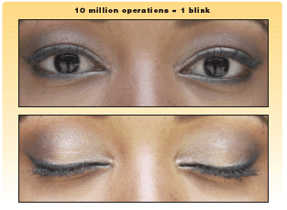
Memory
What is access time?
Amount of time it takes processor to read data from memory
Measured in nanoseconds (ns), one billionth of a second
It takes 1/10 of a second to blink your eye; a computer can perform up to 10 million operations in same amount of time
Term Speed
Millisecond One-thousandth of a second
Microsecond One-millionth of a second
Nanosecond One-billionth of a second
Picosecond One-trillionth of a second
p. 203 Figs. 4-22-4-23
Next

Slide 34
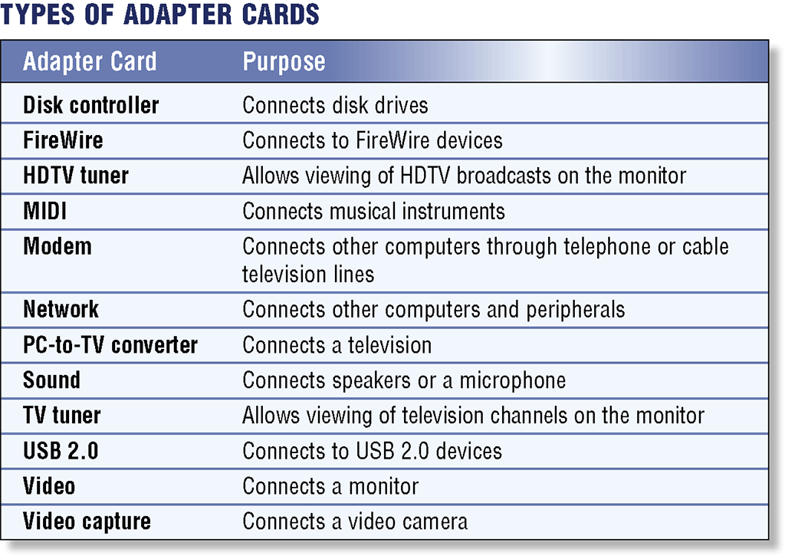
Expansion Slots and Adapter Cards
What is an adapter card?
Enhances system unit or provides connections to external devices called peripherals
Also called an expansion card
Click to view Web Link, click Chapter 4, Click Web Link from left navigation,
then click Video Cards below Chapter 4
p. 204 Fig. 4-24
Next

Slide 35
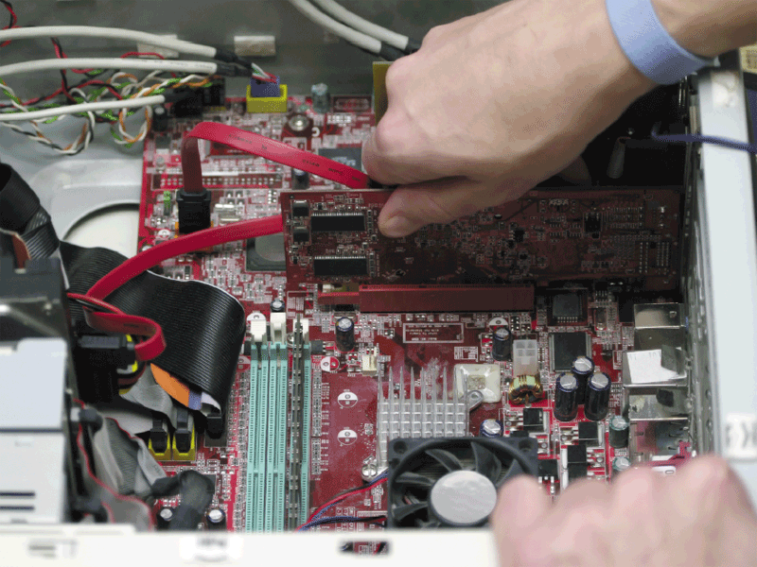
Expansion Slots and Adapter Cards
What is an expansion slot?
An opening, or socket, on the motherboard that can hold an adapter card
With Plug and Play, the computer automatically configures cards and other devices as you install them
p. 204 - 205 Fig. 4-25
Next

Slide 36
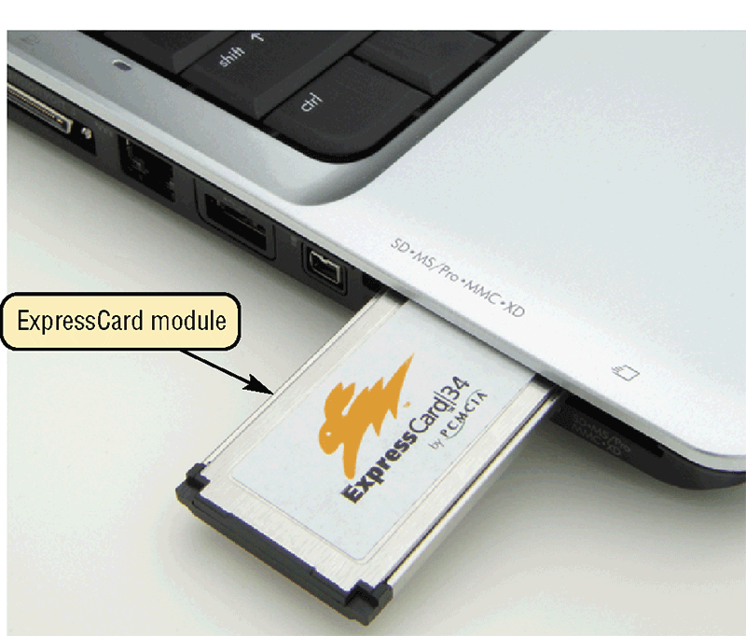
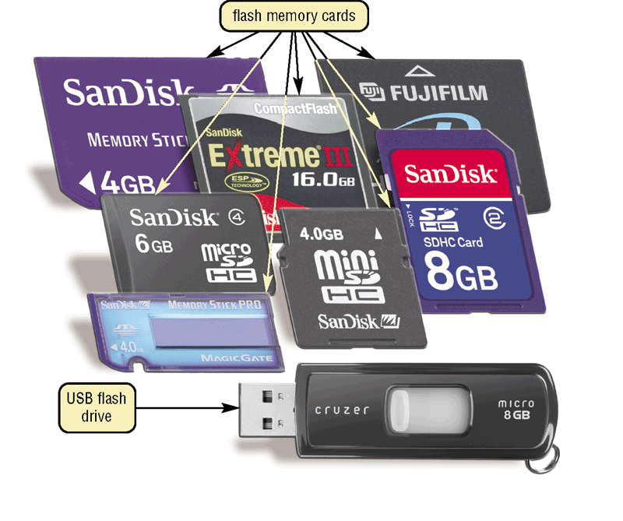
Expansion Slots and Adapter Cards
What are flash memory cards, PC cards, and ExpressCard modules?
An ExpressCard module adds memory, storage, sound, fax/modem, communications, and other capabilities to notebook computers
A flash memory card allows users to transfer data from mobile devices to desktop computers
USB Flash drive
An PC card adds various capabilities to computers
Click to view Web Link, click Chapter 4, Click Web Link from left navigation,
then click ExpressCard Modules below Chapter 4
p. 205 Fig. 4-26–4-27
Next

Slide 37
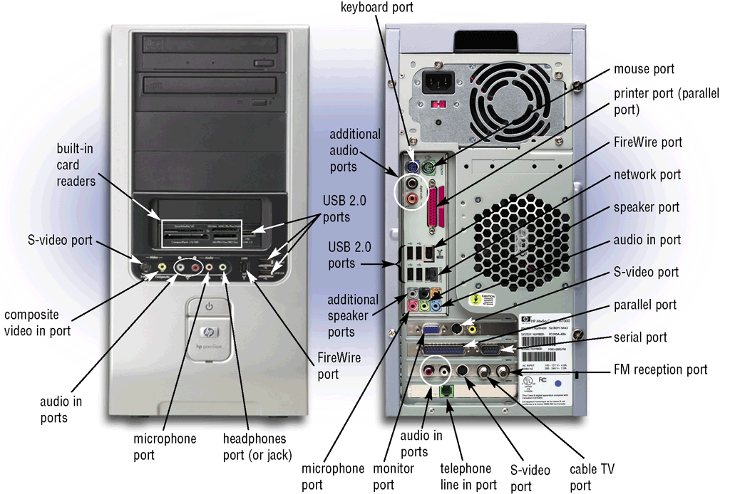
Ports and Connectors
What are ports and connectors?
Port connects external devices to system unit
Connector joins cable to peripheral
Available in one of two genders: male and female
p. 206 Fig. 4-28
Next

Slide 38
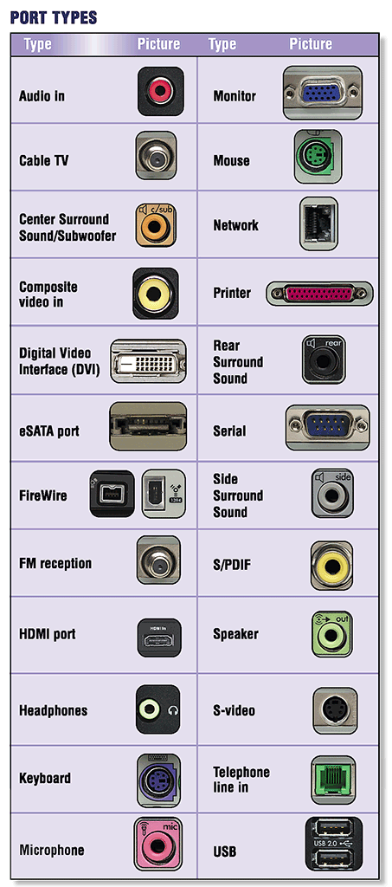
Ports and Connectors
What are different types of connectors?
p. 207 Fig. 4-29
Next

Slide 39
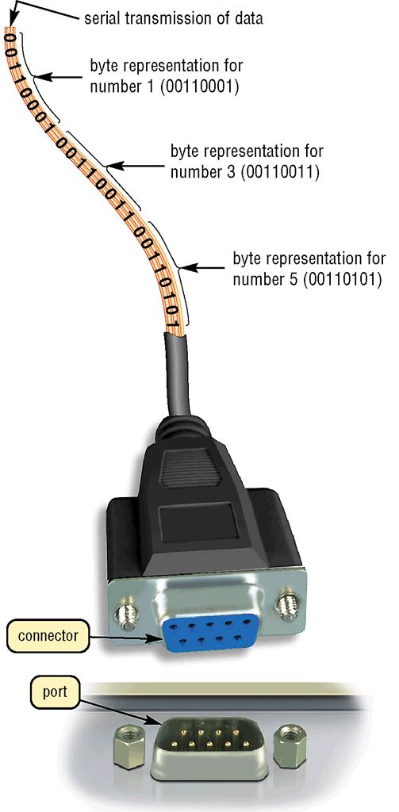
Ports and Connectors
What is a serial port?
Transmits one bit of data at a time
Connects slow-speed devices, such as mouse, keyboard, modem
p. 207 Fig. 4-30
Next

Slide 40
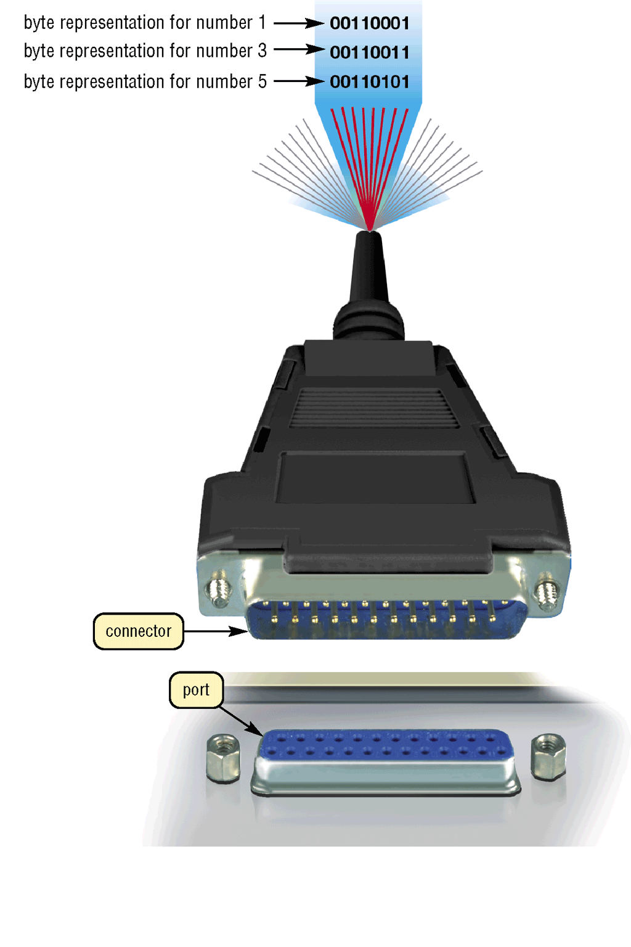
Ports and Connectors
What is a parallel port?
Connects devices that can transfer more than one bit at a time, such as a printer
p. 208 Fig. 4-31
Next

Slide 41
Ports and Connectors
What are USB ports?
USB (universal serial bus) port can connect up to 127 different peripherals together with a single connector type
PCs typically have six to eight USB ports on front or back of the system unit
Single USB port can be used to attach multiple peripherals in a daisy chain
Third USB device connects to second USB device, and so on
Second USB device connects to first USB device
USB 2.0
First USB device connects to USB port on computer
p. 208
Next

Slide 42
Ports and Connectors
What are FireWire ports?
Connects multiple types of devices that require faster data transmission speeds
Allows you to connect up to 63 devices together
FireWire 800 is the latest FireWire version
A FireWire hub is a device that plugs in a FireWire port on the system unit and contains multiple FireWire ports in which you plug cables from FireWire devices
p. 208 - 209
Next

Slide 43
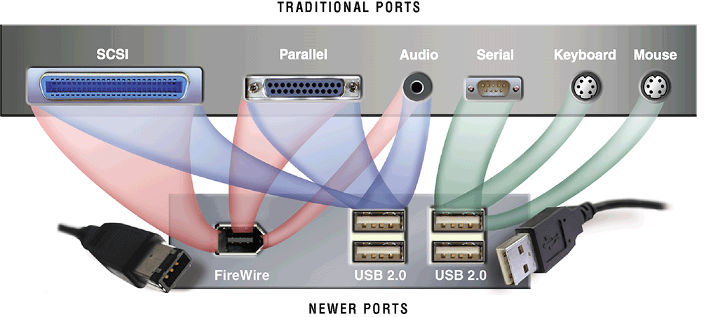
Ports and Connectors
What are special-purpose ports?
Allow users to attach specialized peripherals or transmit data to wireless devices
MIDI (Musical Instrument Digital Interface) port
eSATA port
SCSI port
IrDA (Infrared Data Association) port
Bluetooth port
Click to view Web Link, click Chapter 4, Click Web Link from left navigation,
then click MIDI Ports below Chapter 4
p. 209 - 210 Fig. 4-32
Next

Slide 44
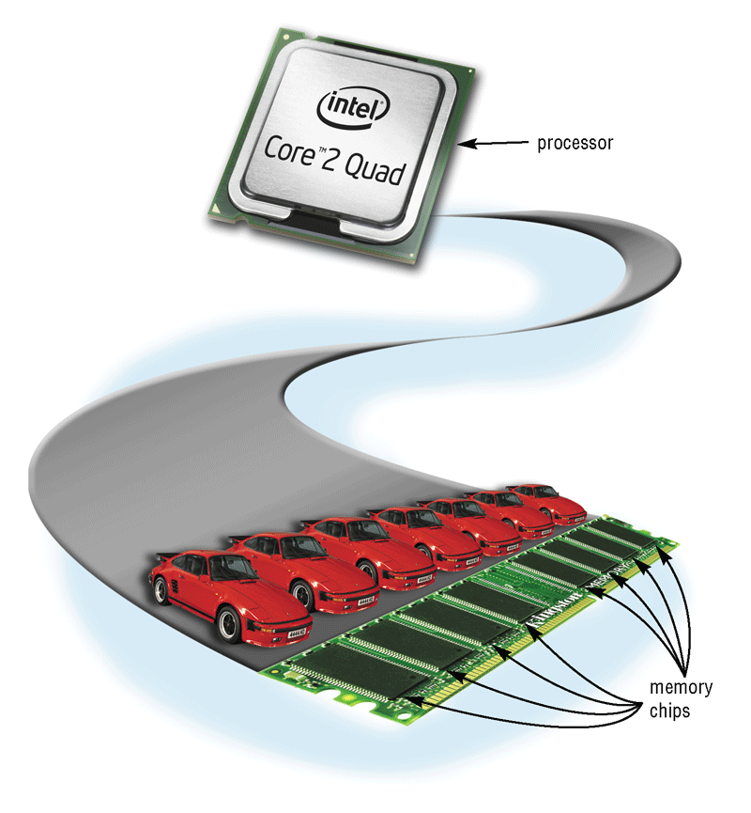
Buses
What is a bus?
Channel that allows devices inside computer to communicate with each other
System bus connects processor and RAM
Bus width determines number of bits transmitted at one time
Word size is the number of bits processor can interpret and execute at a given time
p. 211 - 212 Fig. 4-35
Next

Slide 45
Buses
What is an expansion bus?
Allows processor to communicate with peripherals
PC Card
Bus
PCI Express Bus
AGP Bus
USB
Bus
PCI Bus
p. 212
Next

Slide 46
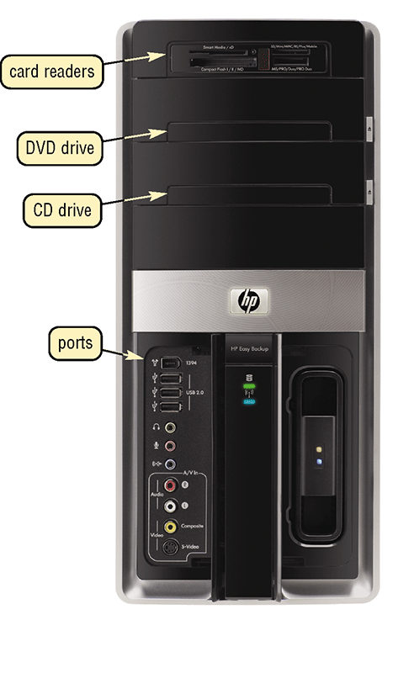
Bays
What is a bay?
Opening inside system unit used to install additional equipment
Drive bays typically hold disk drives
p. 212 Fig. 4-36
Next

Slide 47
Power Supply
What is a power supply?
Converts AC Power into DC Power
Fan keeps system unit components cool
External peripherals might use an AC adapter, which is an external power supply
p. 213
Next

Slide 48
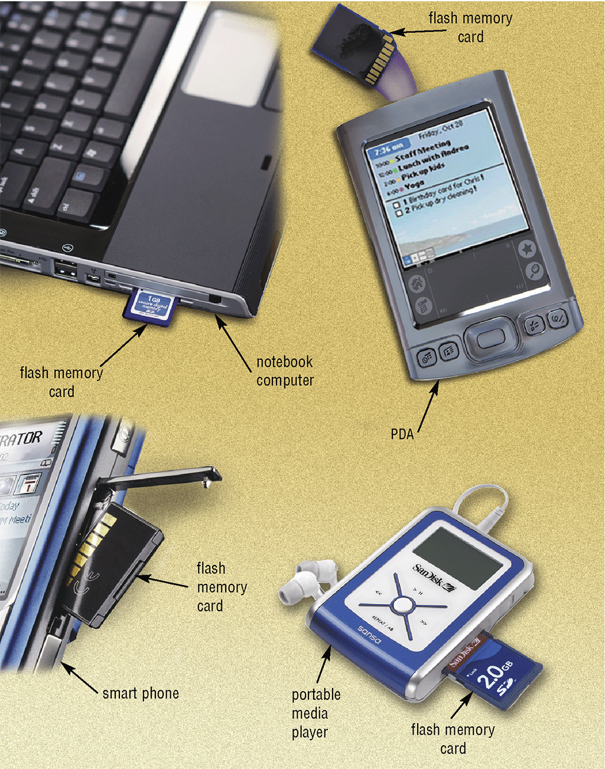
Mobile Computers and Devices
What is a mobile computer?
Notebook, weighing between 2.5 and 10 pounds, or mobile device
p. 213 - 214 Fig. 4-37
Next

Slide 49
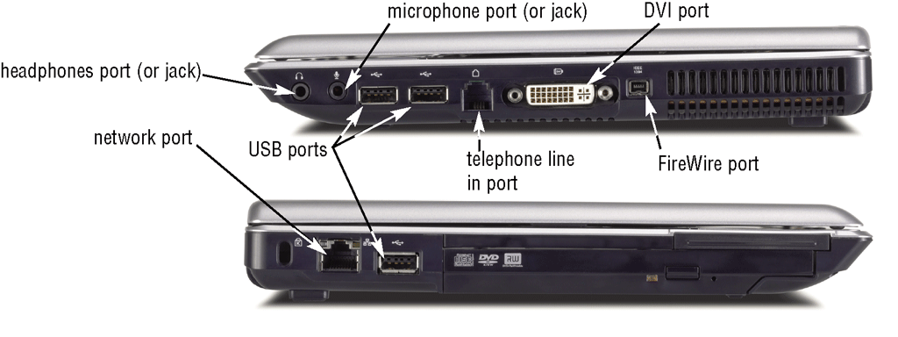
Mobile Computers and Devices
What ports are on a notebook computer?
p. 214 Fig. 4-38
Next

Slide 50
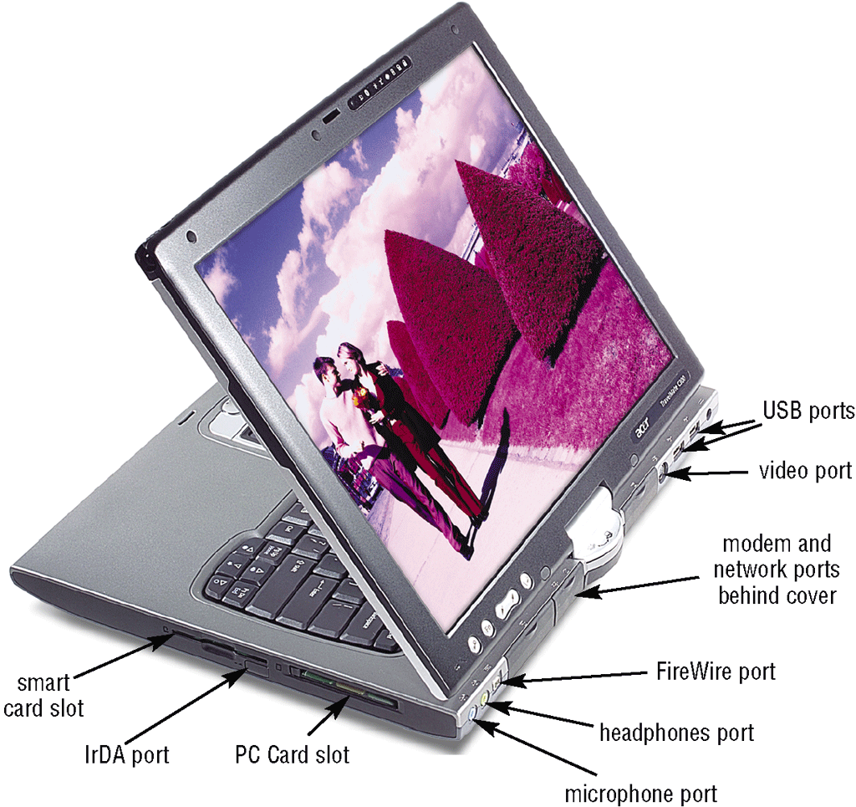
Mobile Computers and Devices
What ports and slots are on a tablet PC?
p. 214 Fig. 4-39
Next

Slide 51
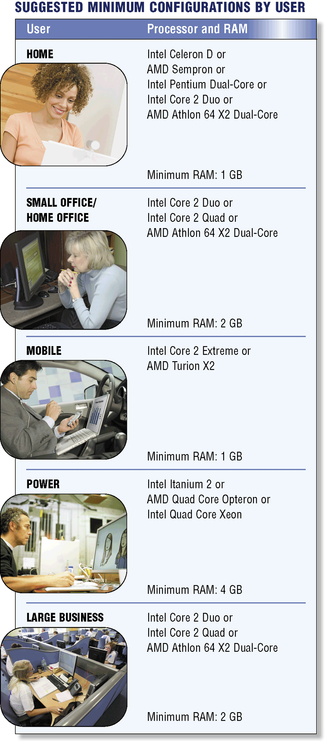
Putting It All Together
What are suggested processor and RAM configurations based on the needs of various types of users?
p. 215 Fig. 4-40
Next

Slide 52
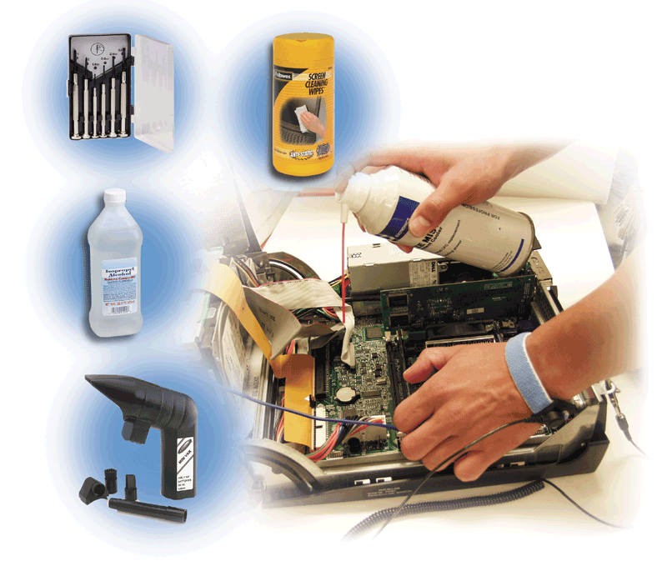
Keeping Your Computer Clean
Over time, the system unit collects dust – even in a clean environment
Preventative maintenance requires a few basic products:
p. 216 Fig. 4-41
Next

Slide 53
Summary of the Components of the System Unit
Components of the system unit
Comparison of various personal computer processors on the market today
How memory stores data, instructions, and information
How to clean a system unit
Sequence of operations that occur when a computer executes an instruction
Chapter 4 Complete

